Slide 1



https://www.isme-microbes.org/seqcode-initiative
Phil Hugenholtz
The University of Queensland
22nd Meeting, Moorea

Slide 2
What is the SeqCode?
A code of nomenclature* for naming prokaryotes according to a set of rules and recommendations
Based on genome sequences as type material
* Codes of nomenclature were developed to ensure that taxa have precise scientific names. To this end, each taxon must have only one name and each name must refer to only one taxon.
Notes:
To only have one name, you need priority to prevent renaming of named taxa

Slide 3
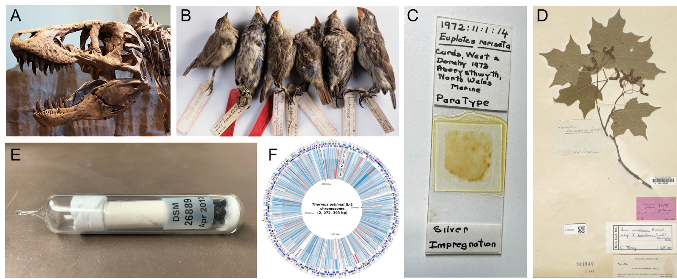
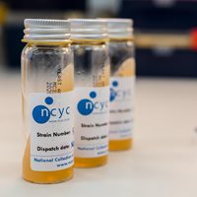
Types of Types
A nomenclatural type, or type, is an “element to which the name of a taxon is permanently attached”
F
Modified from Hedlund, Palmer, Sutcliffe, and Venter (under review)
It’s time for a new type of type to facilitate naming the microbial world.

Slide 4
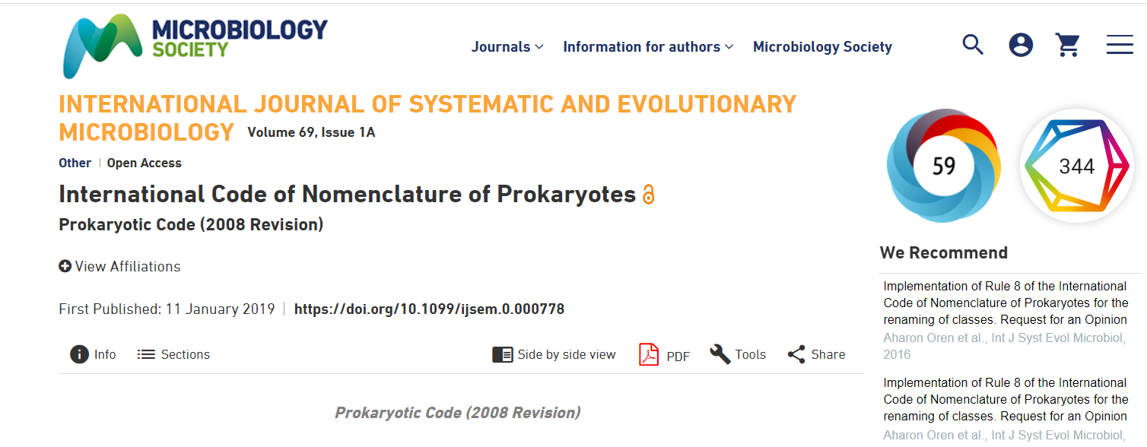
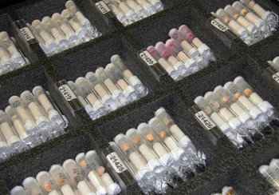
For bacteria and archaea, we use the Prokaryotic Code (ICNP):
And here’s the rub:
As of January 2001 the description of a new species…must include designation of a type strain (pure culture)…deposited in at least two publicly accessible culture collections in different countries…must be available.
Notes:
Prior to 2001, it was even possible to use an illustration as type material! This new requirement is also limited by the Nagoya Protocol which limits ability to send pure cultures between some countries.

Slide 5
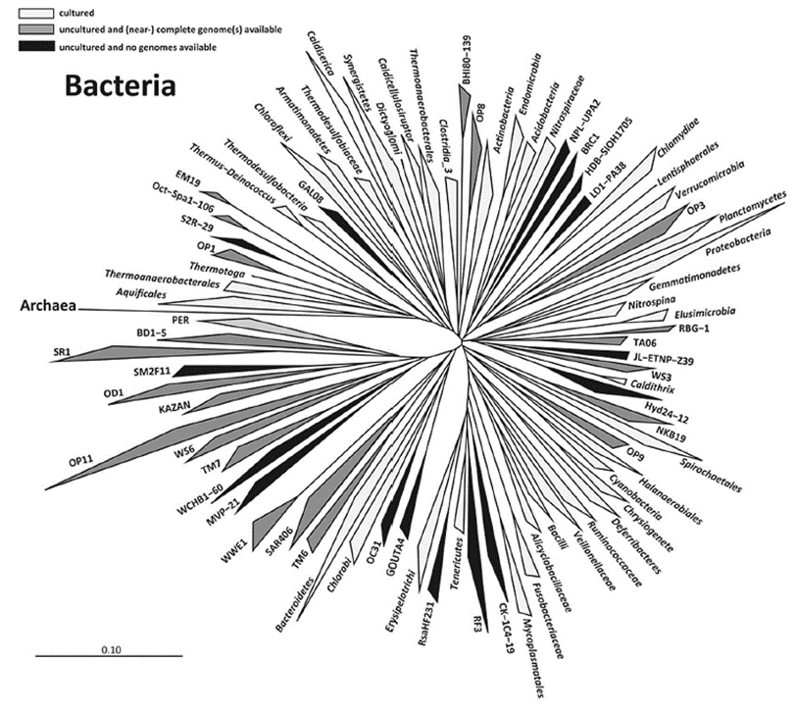
The problem: Most prokaryotes have not been brought into pure culture so most cannot be validly named under the ICNP
Baker & Dick 2012 Microbe
~14,000 species validly named (LPSN)
<1% of total estimated species
~149 bacterial phyla
~46 with pure cultures (GTDB 06-RS202)
~20 archaeal phyla
4 with pure cultures (GTDB 06-RS202)
~85% of phylogenetic diversity is uncultured

Slide 6
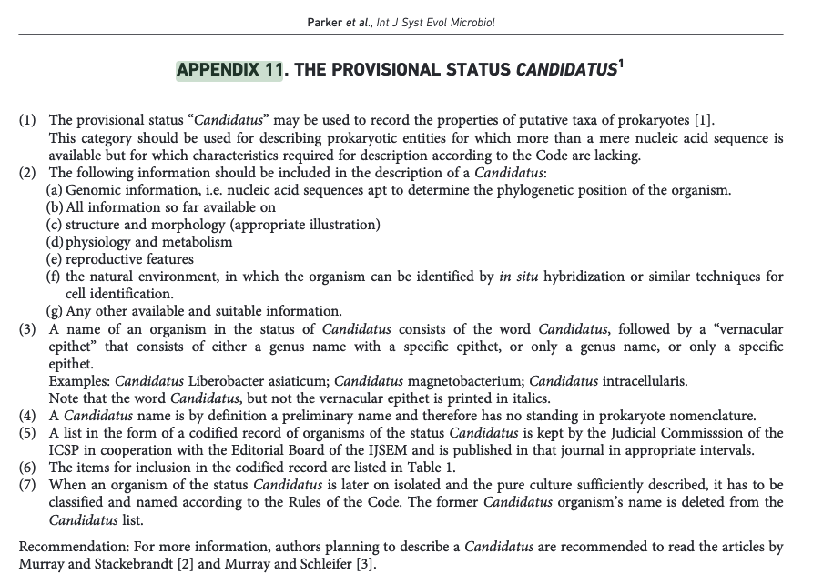
A partial solution (kludge): Candidatus status (Murray & Stackebrandt, 1995)
✅ can be applied to uncultured taxa based on sequence / imaging data
❌ only a provisional name
Not validly published
Doesn’t need to follow the ICNP rules for names
No priority (can be renamed)
Notes:
Recognising this limition (primarily via 16S surveys), a kludge was developed for the Code.

Slide 7
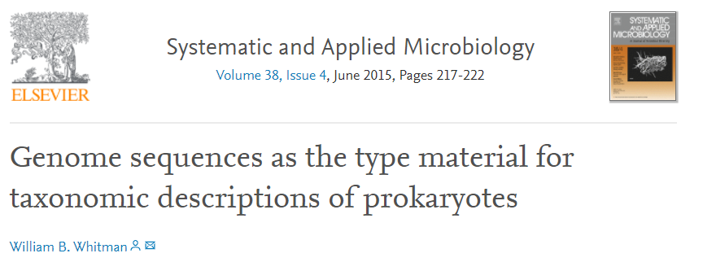

A better solution : Use genome sequences as type material rather than cultures
Available regardless of cultivation
Comparatively cheap and easily shareable
Single best data type to identify a taxon
95% ANI for species (Jain et al., 2019)
Phylogenomic approaches for higher taxa (GTDB)
Same approaches for pure cultures (Chun et al., 2018)

Slide 8
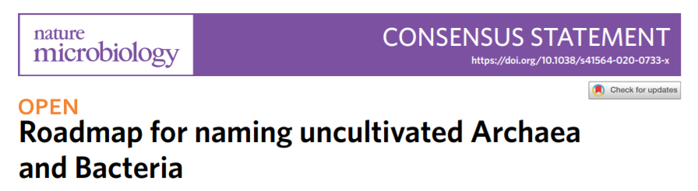

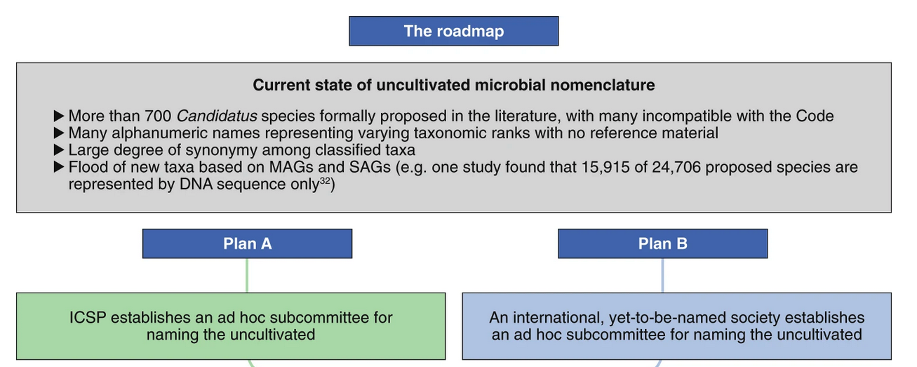

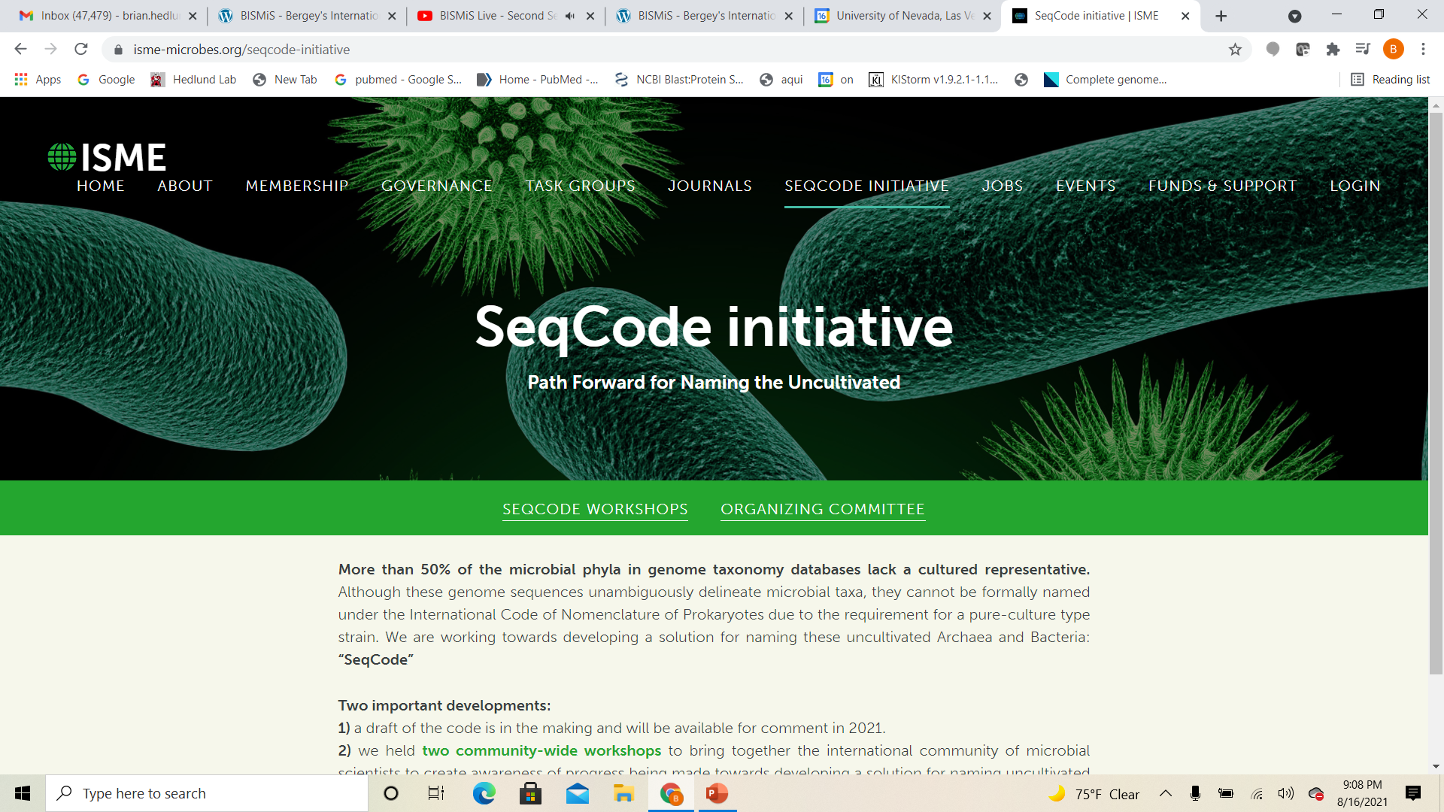
Alison Murray et al., 2020
- endorsed by 65 authors

Slide 9

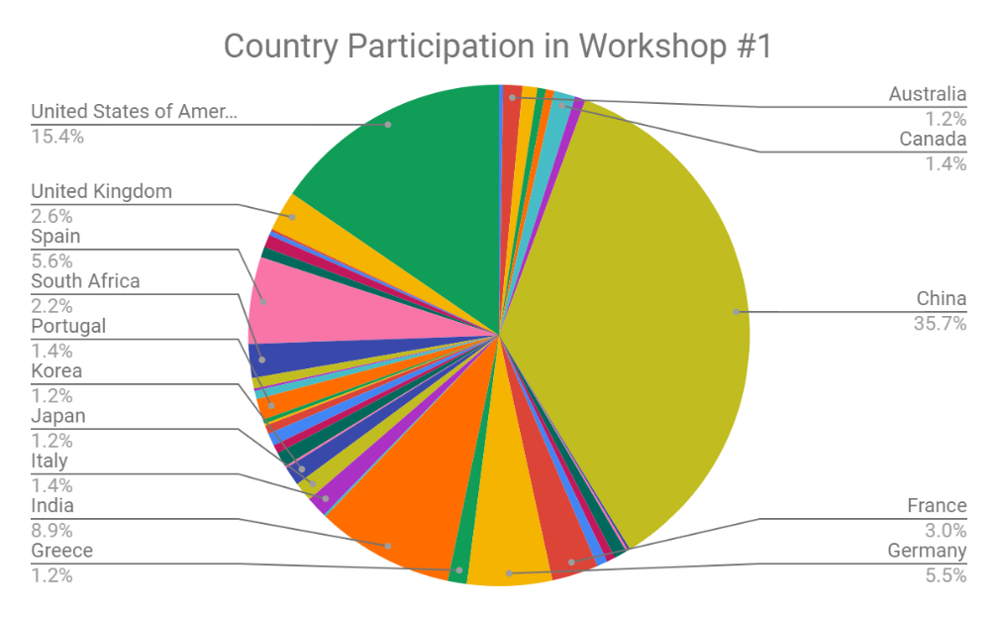
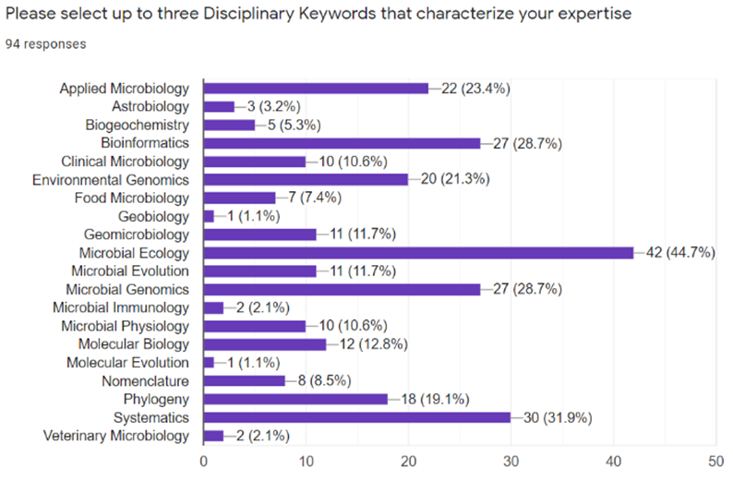
NSF-sponsored SeqCode Workshops (Feb 2021)
Awarded to Hedlund
Reysenbach & Murray
848 Registrants
42 countries, six continents
Broad diversity of subdisciplines
(ecology & systematics)
90% intend to use the SeqCode
https://www.isme-microbes.org/seqcode-initiative

Slide 10
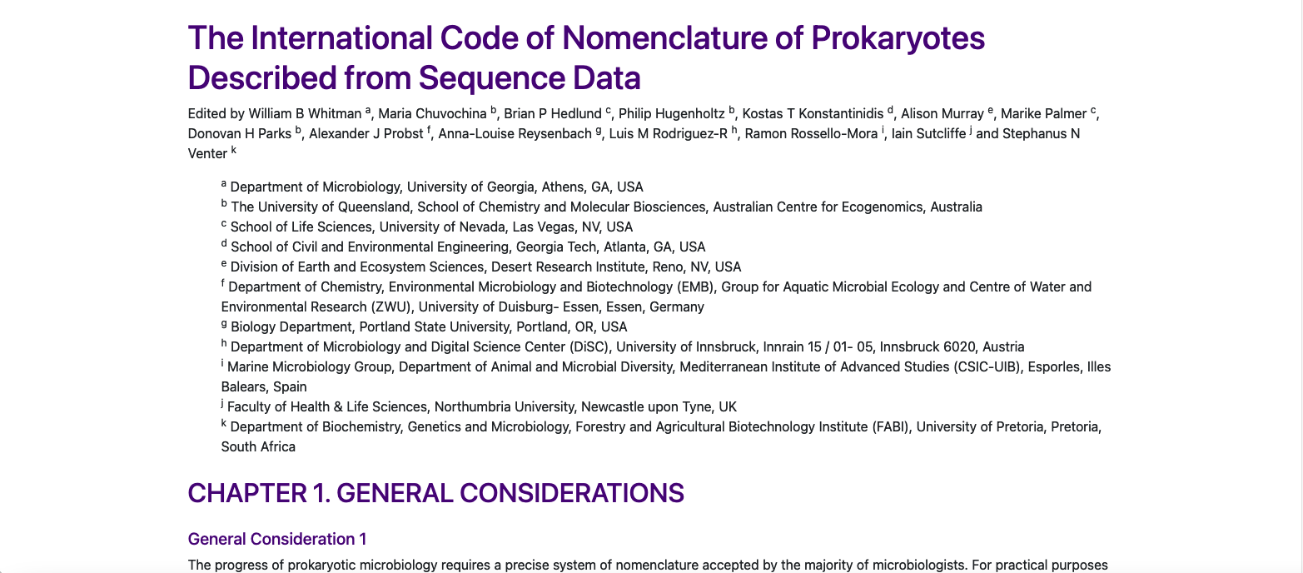
The SeqCode v1.01 (Feb 2022)
first draft heavily based on the ICNP for compatibility

Slide 11
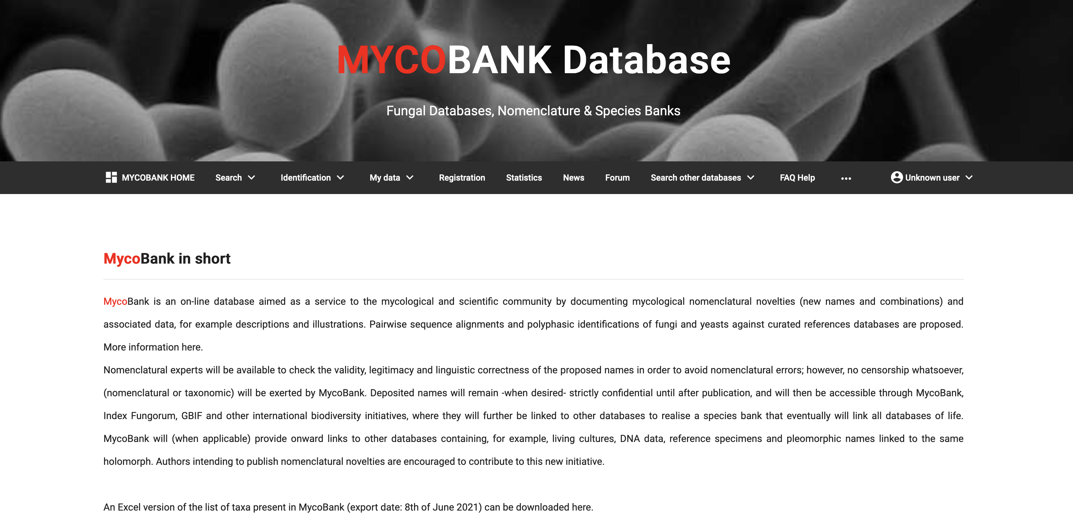
Digital repositories are the way to go
https://www.mycobank.org/

Slide 12
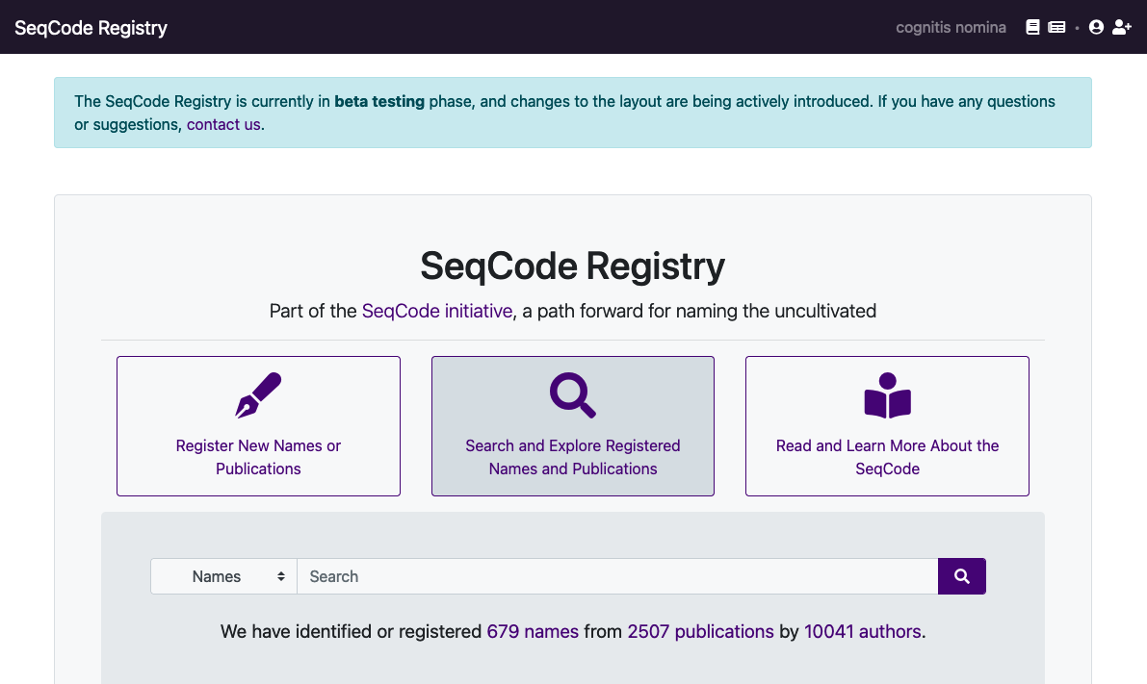
https://seqco.de
Principal developer: Luis M. Rodriguez-R

Slide 13
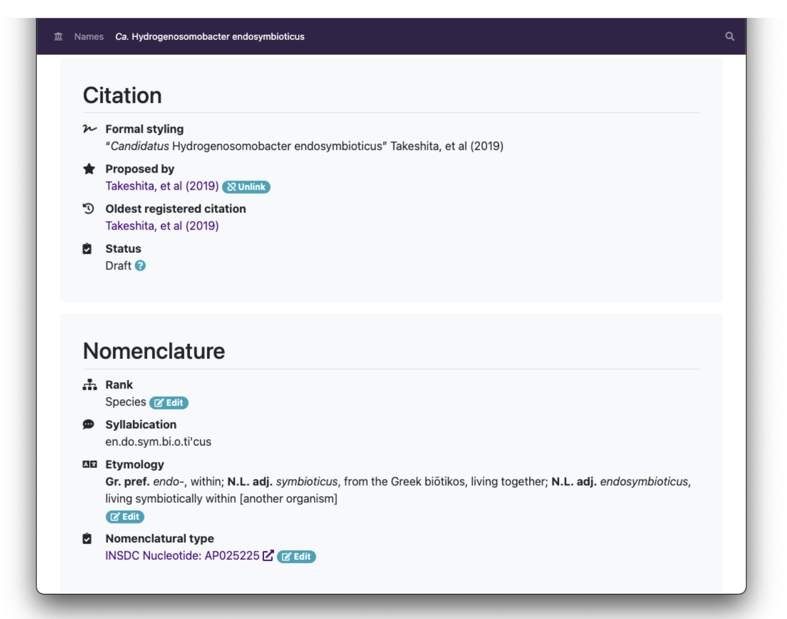
Notes:
Replace with another SeqCode grab from Miguels talk

Slide 14
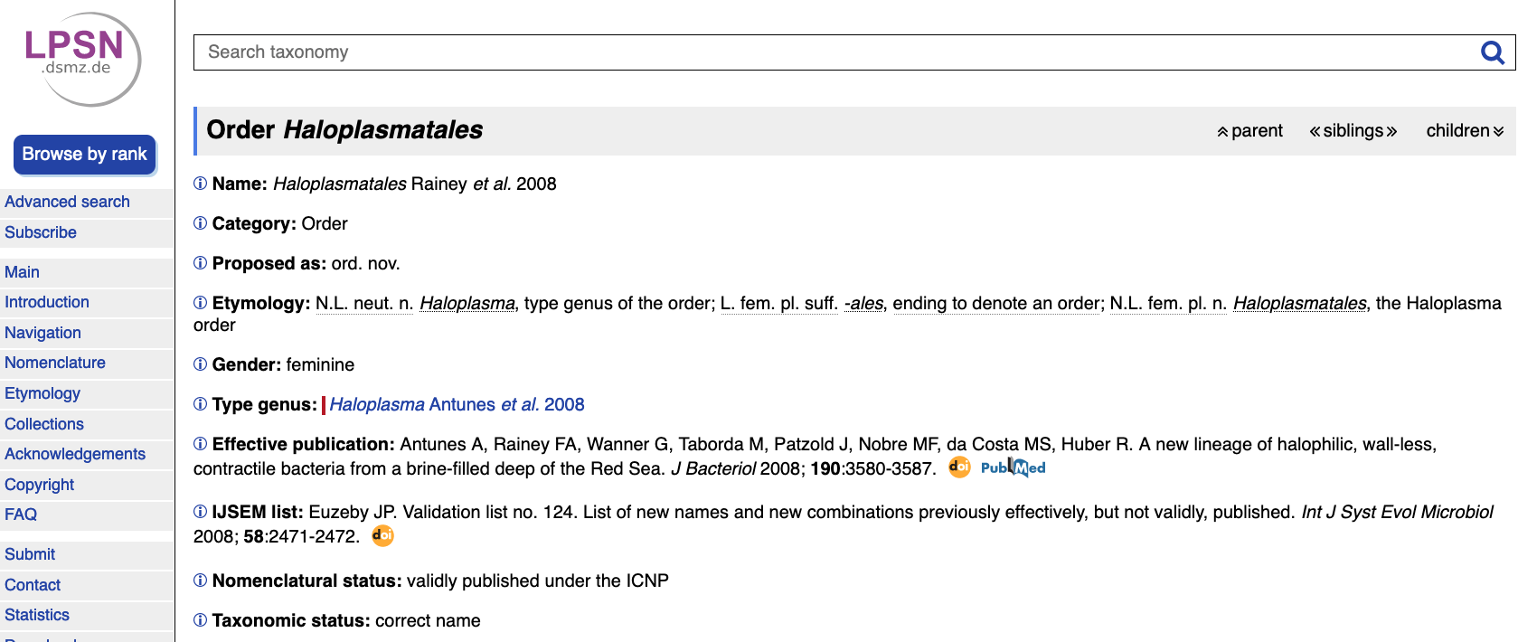

An online registry will reduce this type of error:
bacterial order

Slide 15
Where GSC could play a role
Data quality and availability necessary for completion of SeqCode Registry
 | Requirements | Recommendations
Type genome assembly quality | 1. >90% complete and <5% contaminated; 16S and 23S rRNA genes >75% complete (modified from Bowers et al., 2017). 2. Isolate genome read coverage ≥50x (Field et al., 2008). | 1. >80% of tRNAs present (modified from Bowers et al., 2017). 2. High genome integrity (contig # <100; N50 >25 kb; max. contig >10 kb). 3. MAG/SAG read coverage ≥10x.
INSDC data availability | 1. Assembly available in INSDC database. 2. Raw data available in INSDC databases (e.g., Sequence Read Archive). | 1. Data submission using MIxS Checklists in INSDC databases (https://gensc.org/mixs/). 2. Include as much metadata as possible in INSDC.
From Hedlund et al. (in review) – Preprint available at www.isme-microbes.org/seqcode-initiative
Notes:
Currently only a recommendation

Slide 16


SeqCode Steering Committee
Support
Maria Chuvochina – University of Queensland
Brian Hedlund – University of Nevada, Las Vegas
Phil Hugenholtz – University of Queensland
Kostas Konstantinidis – Georgia Tech
Alison Murray – Desert Research Institute
Marike Palmer – University of Nevada, Las Vegas
Donovan Parks – University of Queensland
Alex Probst – University of Duisburg-Essen
Anna-Louise Reysenbach – Portland State Univ.
Luis Rodriguez-R – University of Innsbruck
Ramon Rossello-Mora – IMEDEA
Fanus Venter – University of Pretoria
Iain Sutcliffe – Northumbria University
Barny Whitman – University of Georgia
Papers under review, see our website for links to preprints and updates:
www.isme-microbes.org/seqcode-initiative
Special thanks for slides!
Notes:
Briefly define SeqCode: a code of nomenclature for naming prokaryotes according to a set of rules and recommendations

